Slide 1
RecipeSource
Final Report - Team 8

Slide 2
Introduction
Cooking at home has become popular during the pandemic.
Sometimes it’s hard to figure out what to make with limited ingredients.
RecipeSource will help you waste less food and eat fantastic meals.

Slide 3
Problem Definition
How to find the most appropriate recipe?
utilizes most (if not all) of the existing ingredients
fewest additional ingredients to buy
least amount of effort in time to prep and cook
Input
array of (arrays of) ingredients available (in form of recipes) in a fridge
Output
Unsupervised
Recipe clustering
Supervised
Prep time prediction
Recipe recommendation

Slide 4
Data Collection
Datasource
Food.com Recipes and Interactions
Consists of 180K+ recipes and 700K+ recipes reviews covering 18 years of user interactions and uploads
Introduced in the following paper - Generating Personalized Recipes from Historical User Preferences
Data Overview
RAW_interactions.csv, RAW_recipes.csv (user id, recipe id, date, rating and review, etc.)
PP_recipes.csv, PP_users.csv (recipe text metadata is tokenized via a GPT subword tokenizer)
Interactions_test.csv, Interactions_train.csv, Interactions_validation.csv (supervised learning)
Preprocessing (example)
Tokenize steps from RAW_recipes.csv
Create word_count Python dictionary (ignoring symbols, nltk stop words and numbers)
Top 5000, token2idx -> compressed CSR matrix (features for both supervised and unsupervised learning)

Slide 5
Methods
Use Mixture of Collaborative and Content Filtering
Matrix Factorization on Ingredient to Recipe and User to Recipe Data
Latent Dirichlet Allocation
Latent Semantic Analysis
Word2Vec
Combine Collaborative Data with Content based Features
RandomForest
XGBoost

Slide 6
Supervised Learning: Cook Time Prediction
Data Preparation
We use words in the recipe steps as features
We remove stop words
Data is stored into a csr sparse matrix
We want to predict whether cook time is short, medium or long
Short = Under 30 Minutes
Medium = 30 Minutes to 2 Hours
Long = Over 2 Hours
We use Random Forest Classifier as Model

Slide 7
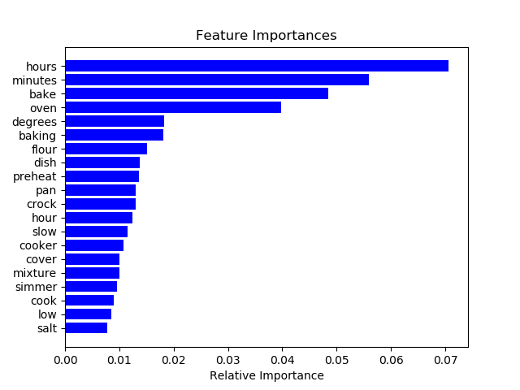
Cook Time Prediction Results
81.6% R^2 on Out of Bag Results
Model does not Overfit

Slide 8
Recipe Clustering
Data Preparation
We use words in the recipe steps as features
We remove stop words
Data is stored into a csr sparse matrix
Use Latent Dirichlet Allocation to create Clusters
Create Word Clouds from Clustered Recipe Names

Slide 9
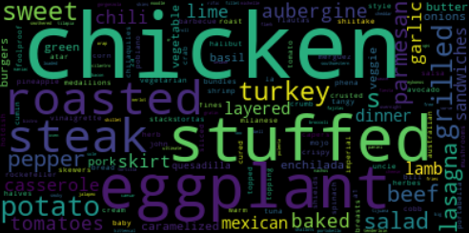
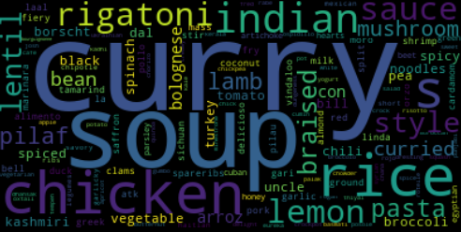
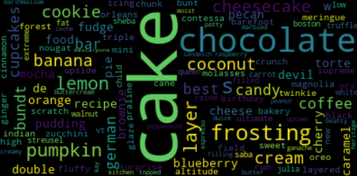
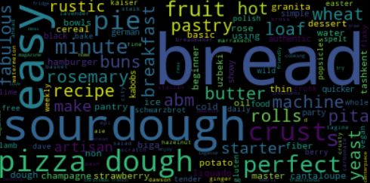
Recipe Cluster Word Clouds

Slide 10


Recommendation system for users and recipe
a matrix factorization-based collaborative filtering, Singular Value Decomposition (SVD)
SVD gets an user latent factor matrix pu and an recipe latent factor matrix qi
Multiplication over two latent factor matrices to get users to recipes ratings
we adopt biases for users bu and items bi to reduce underfitting
The update of the bias and matrix is based on the minimization of the following formula via stochastic gradient descent and regularization on the matrixs and biase
s
.
The minimization of the following formula via stochastic gradient descent and regularization on the matrixs and biases.
The update of the bias and matrix is based on the minimization of the following formula via stochastic gradient descent and regularization on the matrixs and biases.
The update of the bias and matrix is based on the minimization of the following formula via stochastic gradient descent and regularization on the matrixs and biases.
The update of the bias and matrix is based on the minimization of the following formula via stochastic gradient descent and regularization on the matrixs and biases.

Slide 11
Recommendation system
We filter users with fewer than 30 rating reviews out. This filtering way can avoid data sparsity problem for SVD and achieve generality.
The number of rating reviews reduces from 1,132,367 to 674,349, which results in users’ sufficient rating signal for later supervised learning for rating regression. (train : test =3:1 )
To find the best parameters in this method, we adopt Grid Search with 3-fold Cross Validation over parameter
grids = {'training epochs': [5], 'learning rate': [0.05, 0.005,0.0005], 'regularization term': [0.1, 0.3]}

Slide 12
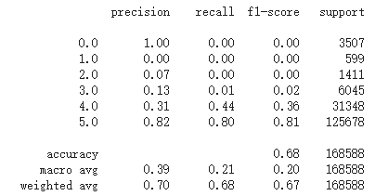
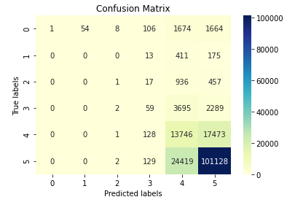
Second Best setting by grid search
'lr_all': 0.005, 'reg_all': 0.3

Slide 13
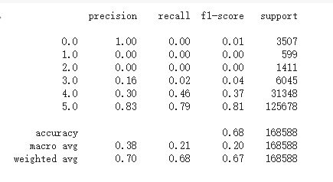
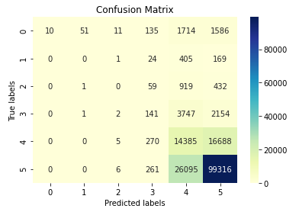
Best setting by grid search
'lr_all': 0.005, 'reg_all': 0.1

Slide 14
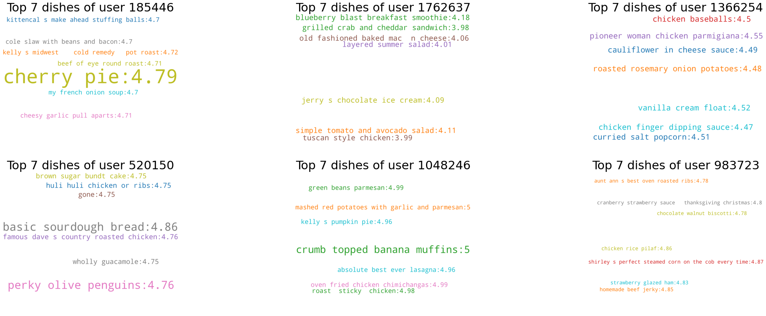
Word clouds show user top dishes with rating

Slide 15
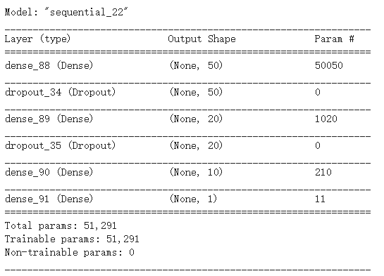


Average rating for recipes regardless of users
We process steps into a string and
remove stop words. Then, we use its
tf-idf format as features and predict
the average rating for each recipe.
Train:Test=3363:1122 (30 reviews up)

Slide 16
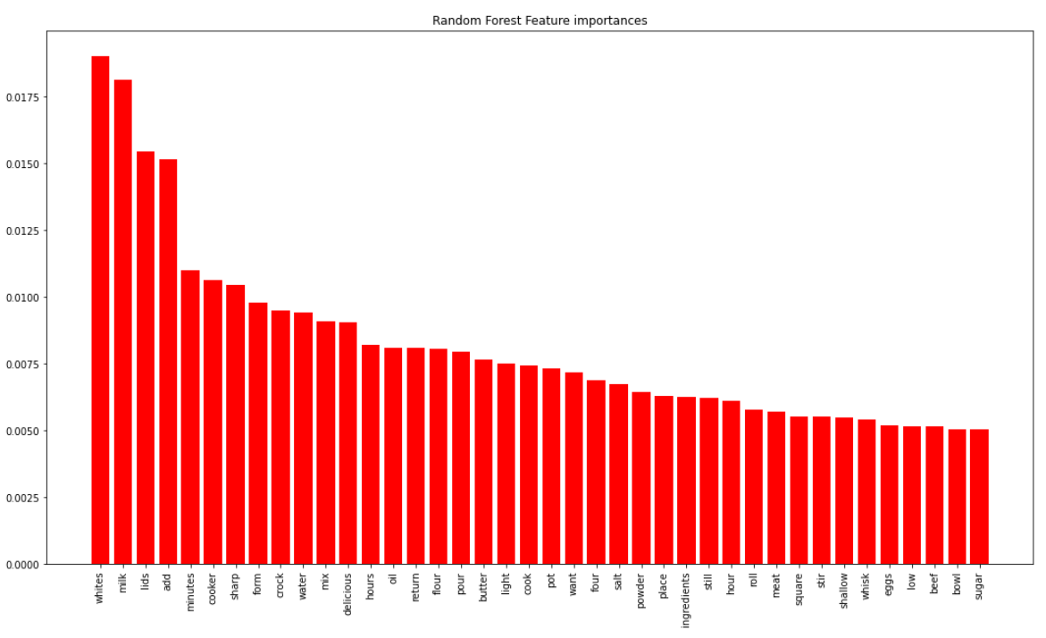
feature importance in Random Forest

Slide 17
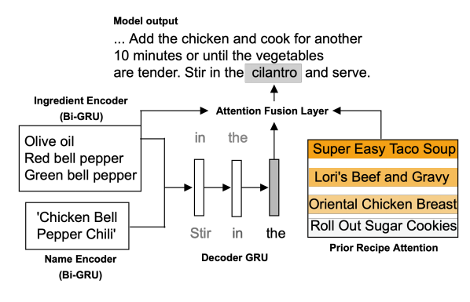
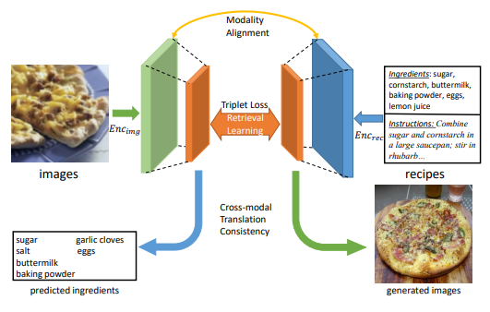
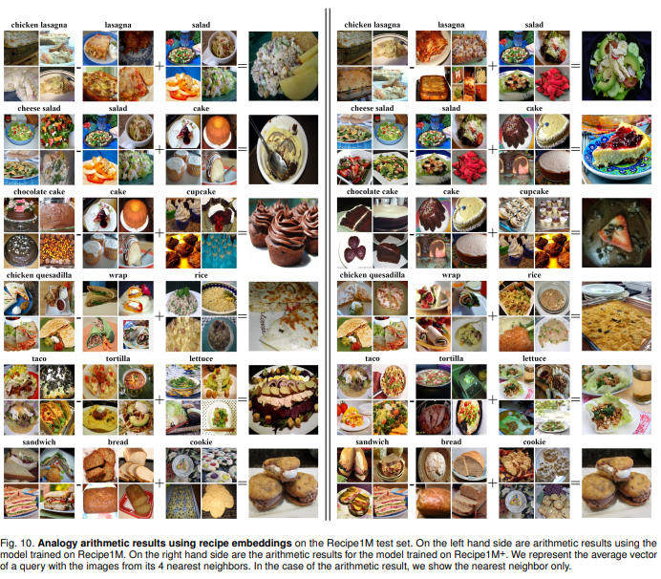
Discussion
We will use silhouette coefficient or mutual information to evaluate the performance of our clusters; And evaluation metrics such as Mean Absolute Error and F-score to evaluate the performance of the recommendation system.
Future work (not in our current plan of actions)
More personalized recommendations through natural language generation.
EMNLP2019: Generating Personalized Recipes from Historical User Preferences
Adopt or revise more receipt datasets or embeddings for better clustering and recommendation
CVPR 2019: Learning Cross-Modal Embeddings with Adversarial Networks for Cooking Recipes and Food Images
IEEE 2018: Recipe1M+: A Dataset for Learning Cross-Modal Embeddings for Cooking Recipes and Food Images

Slide 18
References
S. C. Deerwester, S. T. Dumais, T. K. Landauer, G. W. Furnas, R. A. Harshman, J. Am. Soc. Inf. Sci. 41, 391 (1990)
D. Blei, A. Ng, and M. Jordan. Latent Dirichlet allocation. In Advances in Neural Information Processing Systems 14, 2002
Mikolov, T., Grave, E., Bojanowski, P., Puhrsch, C., and Joulin, A. (2017). Advances in pre-training distributed word representations. arXiv preprint arXiv:1712.09405.
L. Breiman. Random forests. Machine Learning, 45(1): 5–32, 2001. 18
Tianqi Chen and Carlos Guestrin. Xgboost: A scalable tree boosting system. In Proceedings of the 22Nd ACM SIGKDD International Conference on Knowledge Discovery and Data Mining, pages 785–794. ACM, 2016.
F.O. Isinkaye, *, Y.O. Folajimi, B.A. Ojokoh. Recommendation systems: Principles, methods and evaluation
Bodhisattwa Prasad Majumder*, Shuyang Li*, Jianmo Ni, Julian McAuley. Generating Personalized Recipes from Historical User Preferences. EMNLP, 2019

